Slide 2
Class 11
UDFs

Slide 3
Turn video on, open chat,
greet your colleagues in the chat!
Warmup discussion:
What shows are you watching these days?

Slide 4
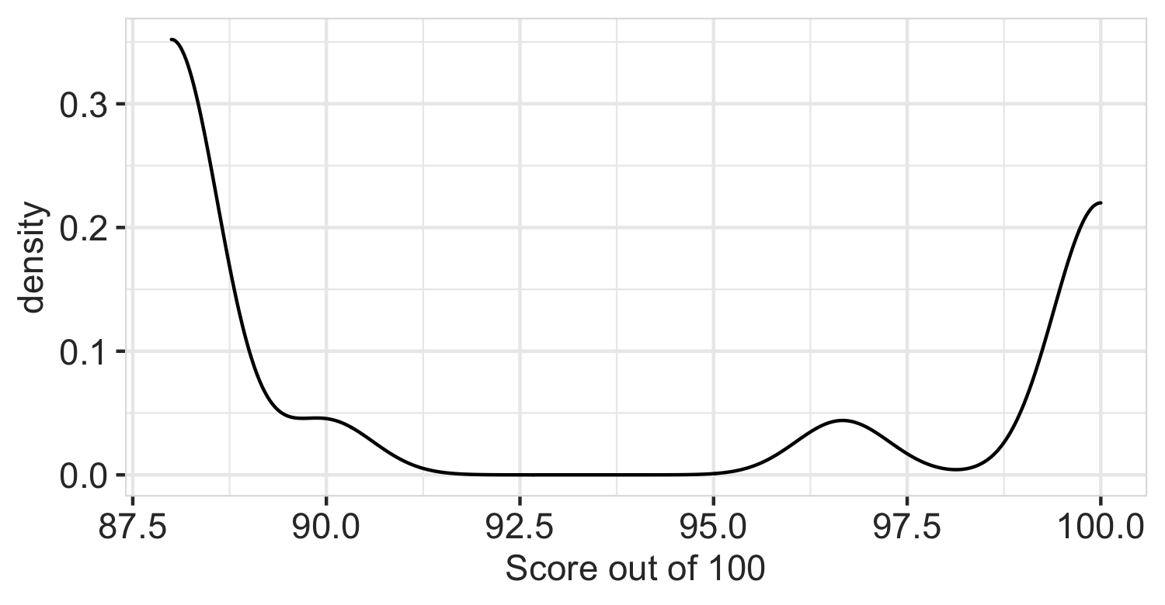
Logistics
A2 graded, reference code is out
A3 due 10/21
Paper draft: 11/29

Slide 5
DB seminar talks
TODAY
9/29 Julia Stoyanovich (NYU)
Responsible Data Management
10/13 Wolfgang Gatterbauer (Northeastern)
QueryVis
10/20 Kostas Karanasos (Microsoft Gray Labs)
Lab overview + In-db ML inference
10/27 Vasiliki Kalavri (Boston U)
Streaming Research
11/10 Aaron Elmore (UChicago)
CrocodileDB
Zoom link in slack

Slide 6
Each group assigns notetaker
G1: Come up with some killer use cases for UDFs. (Combined with user defined types, UDFs are very powerful!)
G2: WHEN and HOW do UDFs pose a problem for query optimization and execution?
G3: Beyond caching, what other tricks might accelerate queries that use UDFs

Slide 7
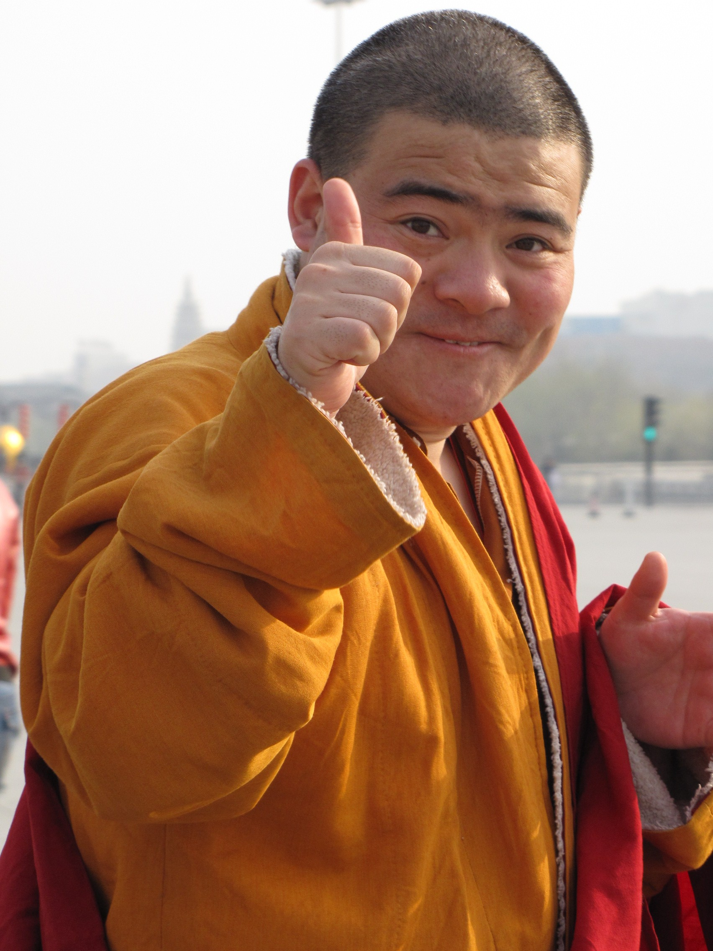
Support your colleagues
for speaking up
A quick thanks or follow up
is great
https://en.wikipedia.org/wiki/Thumb_signal

Slide 8
Each group assigns notetaker
G1: Come up with some killer use cases for UDFs. (Combined with user defined types, UDFs are very powerful!)
G2: WHEN and HOW do UDFs pose a problem for query optimization and execution?
G3: Beyond caching, what other tricks might accelerate queries that use UDFs

Slide 9
Class 10
Query Compilation

Slide 10
Turn video on, open chat,
greet your colleagues in the chat!
Warmup discussion:
What are some types of disaggregation in your daily life?
When is it sensible to disaggregate vs consolidate?

Slide 11

Logistics
Thanks for the bug reports!
Vote: Share and review paper drafts (due 10-22)?

Slide 12
DB seminar talks
9/29 Julia Stoyanovich (NYU)
Responsible Data Management
10/13 Wolfgang Gatterbauer (Northeastern)
QueryVis
10/20 Kostas Karanasos (Microsoft Gray Labs)
Lab overview + In-db ML inference
10/27 Vasiliki Kalavri (Boston U)
Streaming Research
11/10 Aaron Elmore (UChicago)
CrocodileDB
Zoom link in slack

Slide 13
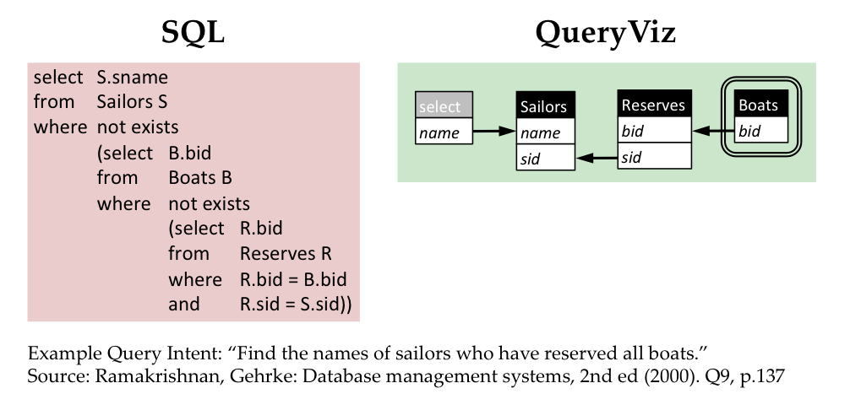
Queryvis.com

Slide 14
Breakout Qs
Choose a notetaker that as not been a notetaker in the past

Slide 15
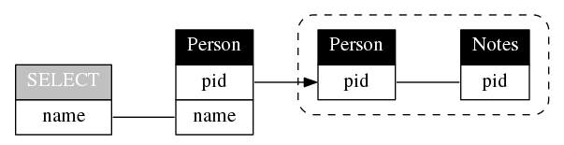
Breakout Qs
Choose a notetaker that as not been a notetaker in the past
SELECT name
FROM Person P
WHERE P.pid NOT IN (
SELECT P2.pid
FROM Person P2, Notes N
WHERE P2.pid = N.pid
)

Slide 16
Breakout Qs.
G1: Compare Hyper’s compilation vs MonetDB’s vectorization or Volcano. In what specific cases is one better and why?
G2: What logic makes sense to keep in C++ as opposed to LLVM? List some examples and why.
G3: How is query compilation tricky from a software engineering perspective? What could be done to improve this aspect?
Each group assigns notetaker to report back (1m)

Slide 17
Support your colleagues
for speaking up
A quick thanks or follow up
is great
https://en.wikipedia.org/wiki/Thumb_signal

Slide 18
Breakout Qs.
G1: Compare Hyper’s compilation vs MonetDB’s vectorization or Volcano. In what specific cases is one better and why?
G2: What logic makes sense to keep in C++ as opposed to LLVM? List some examples and why.
G3: How is query compilation tricky from a software engineering perspective? What could be done to improve this aspect?
Each group assigns notetaker to report back (1m)

Slide 19
Class 9
Cloud DBs

Slide 20

Turn video on, open chat, then click
Warmup discussion:
You’ve read industry and academic papers.
What do you feel are the strengths and weaknesses?

Slide 21
Logistics
A3 released
A5 is extra credit (optional)
Proposal comments sent via slack
Keeping existing lecture sequencing
was partly to time with Prof Vasiliki’s talk

Slide 22
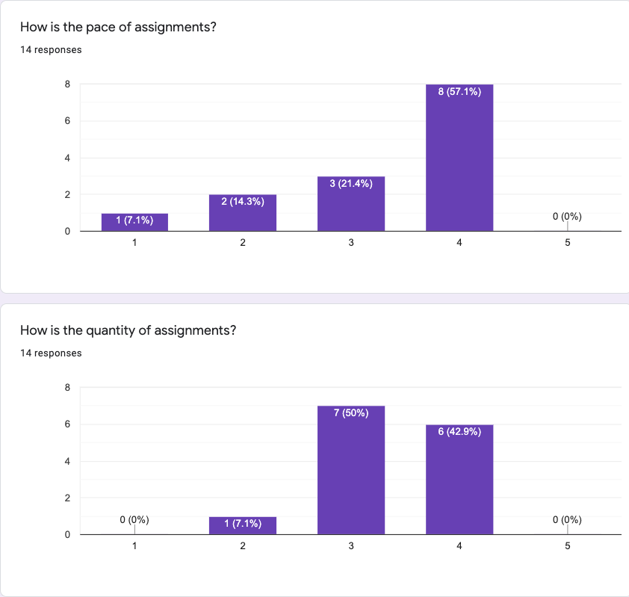
Comments
Almost Unrelenting
Go over assignment & concepts in class (x2)
More tests (x4)
Note: 5 late days

Slide 23
Breakout Qs.
G1: What are the similarities between Dremel/Snowflake and Gamma? What are the differences?
G2: Does in-situ processing really mean? For instance, does data not need to be loaded? What are its strengths and drawbacks?
G3: Speculate about future iterations software or hardware “disaggregation. How might it affect DBMS design?
Each group assigns notetaker to report back (1m)

Slide 24
Class 8
Column Stores

Slide 25
Turn video on, open chat, then click
Warmup discussion:
Which restaurant do you want to go most
when dine-in is safe again?

Slide 26
Logistics
Proposal due today 11:59PM EST
A2 due 10/4 11:59PM EST
A5 is now optional
Questions
Extend A3 and A4 by 1 week?
Swap Compilation/Udf topics with large scale dataflow?

Slide 27
Breakout Qs.
G1: What makes this paper well-written? Identify specific examples from the reading.
G2: Still assuming a ”big reads” workload, how would col-stores adapt to data distribution changes?
G3: Compare and contrast the in-memory vs on-disk “stores” in c-store to the design in a class RDBMS
Each group assigns notetaker to report back (1m)

Slide 28
Class 7
Query Optimizer

Slide 29
Turn video on, open chat
Warmup discussion:
Is a hot dog a sandwich?
3. Click when done

Slide 30
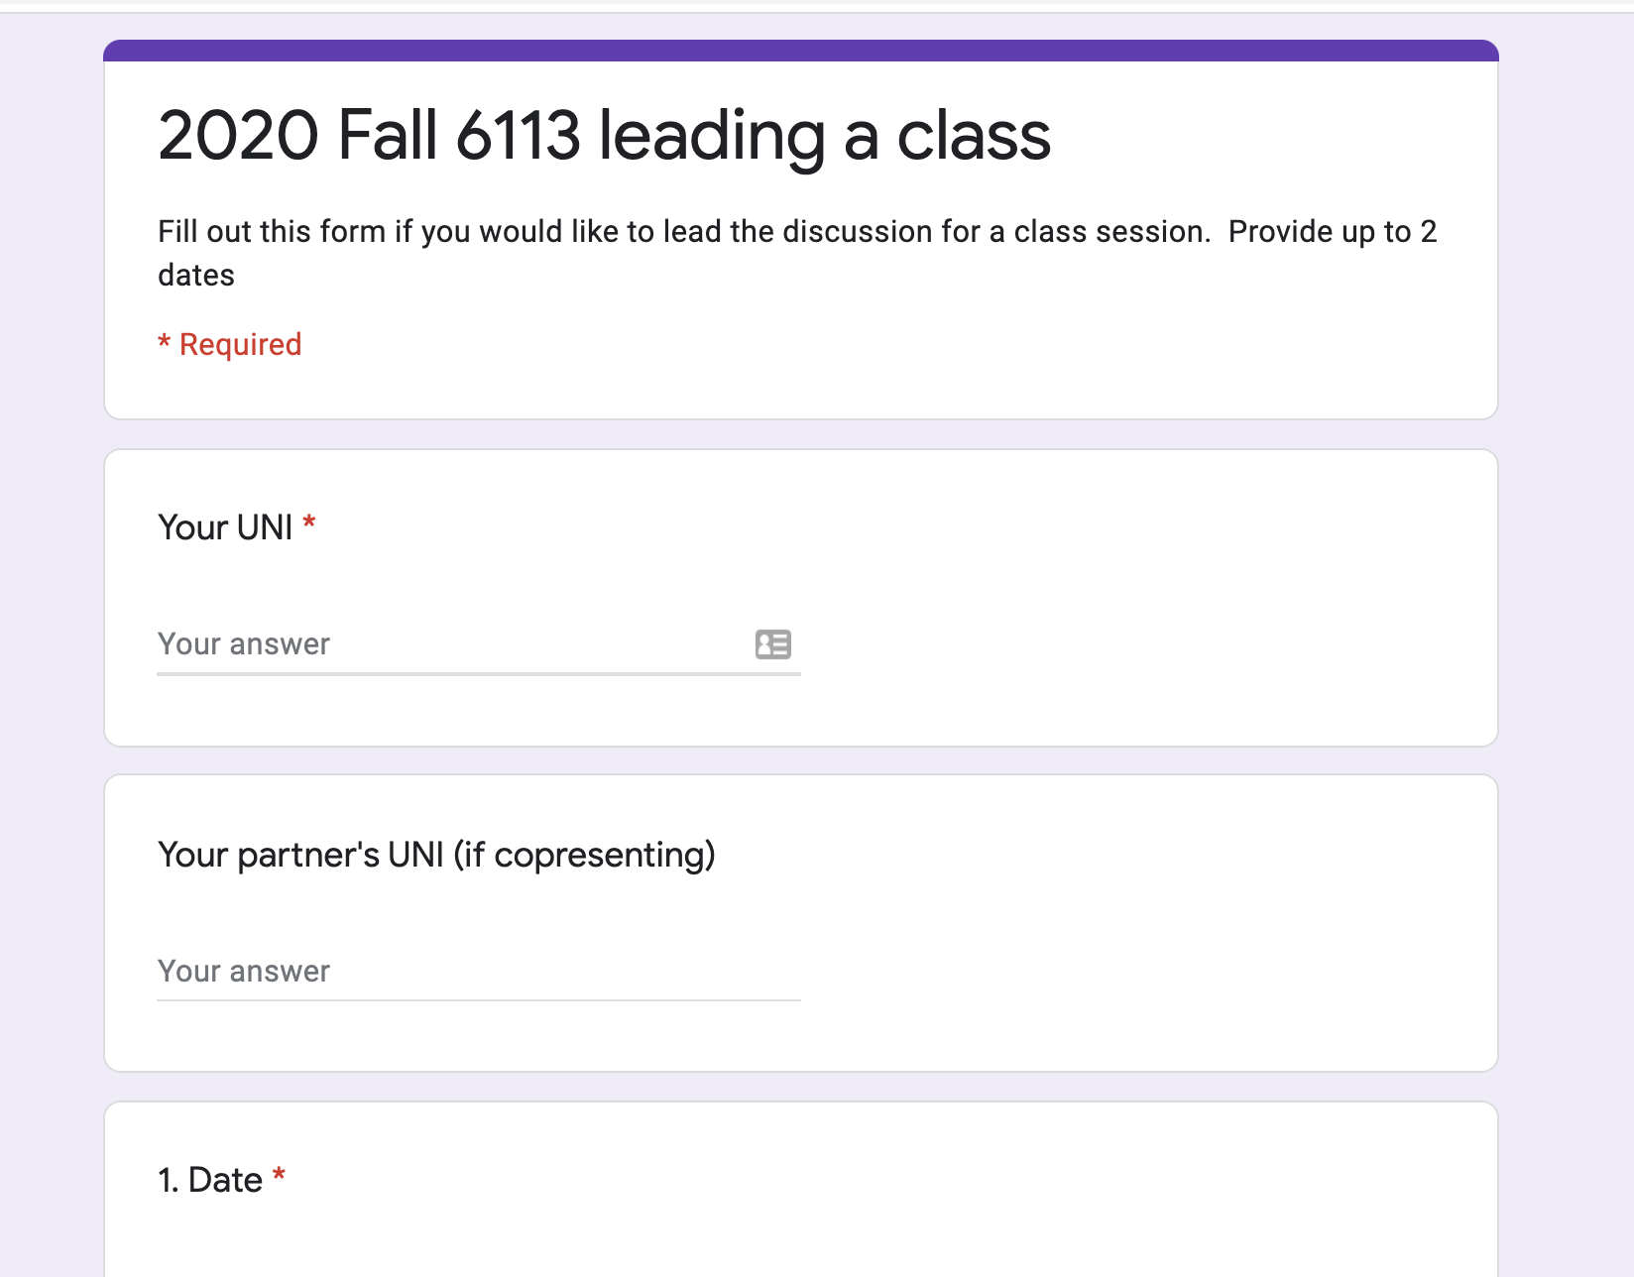
Logistics
Project proposals due 10/1
A2 due 10/4
Sign up to lead a class (TODAY)

Slide 31
DB seminar talks
9/29 Julia Stoyanovich (NYU)
Responsible Data Management
10/13 Wolfgang Gatterbauer (Northeastern)
QueryVis
10/20 Kostas Karanasos (Microsoft Gray Labs)
Lab overview + In-db ML inference
10/27 Vasiliki Kalavri (Boston U)
Streaming Research
11/10 Aaron Elmore (UChicago)
CrocodileDB
Zoom link in slack

Slide 32
Breakout Qs.
G1: Why is writing query optimizers harder than rocket science?
G2: Propose good methods to select promising transitions
G3: What are some benefits of volcano’s top-down search as compared to selinger’s algorithm? Hint: consider enforcers
G4: How to parallelize cascades? What challenges may arise?
Each group assigns notetaker to report back (1m)

Slide 33
Class 6

Slide 34
Do The Following
Turn video on
Type in chat or say:
Agree or disagree
Batman is a criminal
3. Click when done

Slide 35
Logistics
Project proposals due 10/1
A2 due 10/4
Sign up to lead a class (link on website, slack)

Slide 36
DB seminar talks
9/29 Julia Stoyanovich (NYU)
Responsible Data Management
10/13 Wolfgang Gatterbauer (Northeastern)
QueryVis
10/20 Kostas Karanasos (Microsoft Gray Labs)
Lab overview + In-db ML inference
10/27 Vasiliki Kalavri (Boston U)
Streaming Research
11/10 Aaron Elmore (UChicago)
CrocodileDB
Zoom link in slack

Slide 37
Breakout Qs. Provide specific examples
G1 Writing: What did the paper focus on & not focus on? Why?
G2 Contribs: What is the main contribution?
Design an example that highlights it against prior work.
G3 Exps: Based on the paper’s aims, what exps should they have run? Did they? If not, design a specific exp they should have run.
G4 Future: Describe a major follow up question to study.
Each group assigns notetaker to report back (1m)

Slide 38
Breakout
Discussion:
Discuss
Notetaker:
Summarize the discussion (~30s)

Slide 39
Class 5

Slide 40
Do The Following
Turn video on
Type in chat or say:
My favorite time of day is
___ ______
3. Click when done

Slide 41
Logistics
Today: multi-machine joins
A2 is out – optimizer!
A1 – what did you learn? What did you already know?

Slide 42
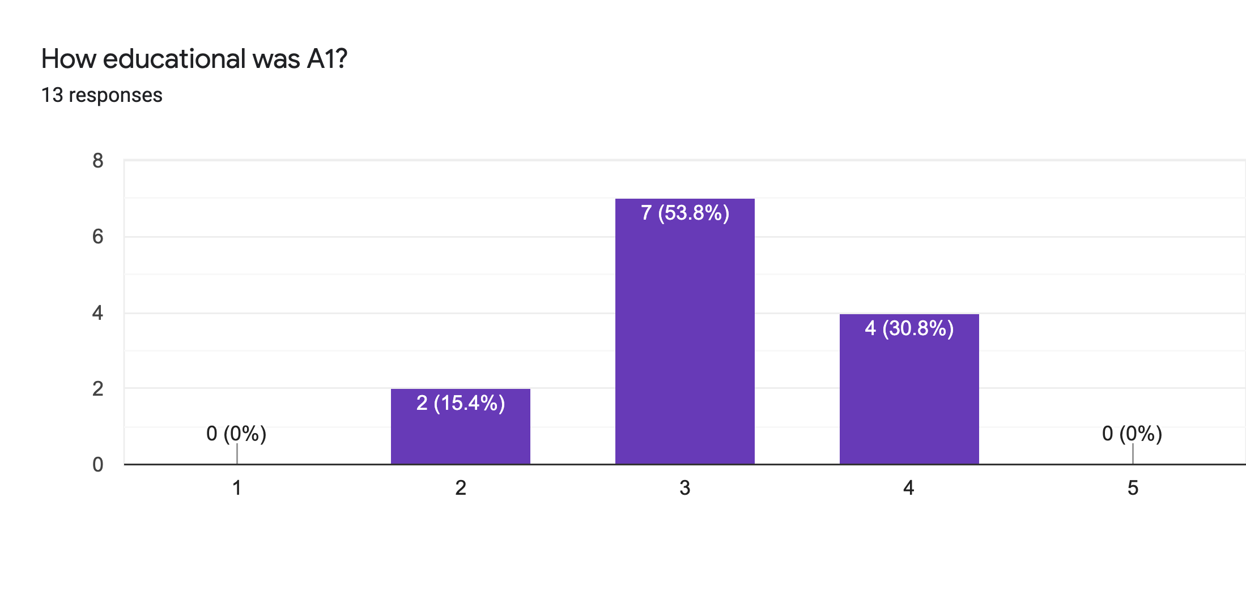
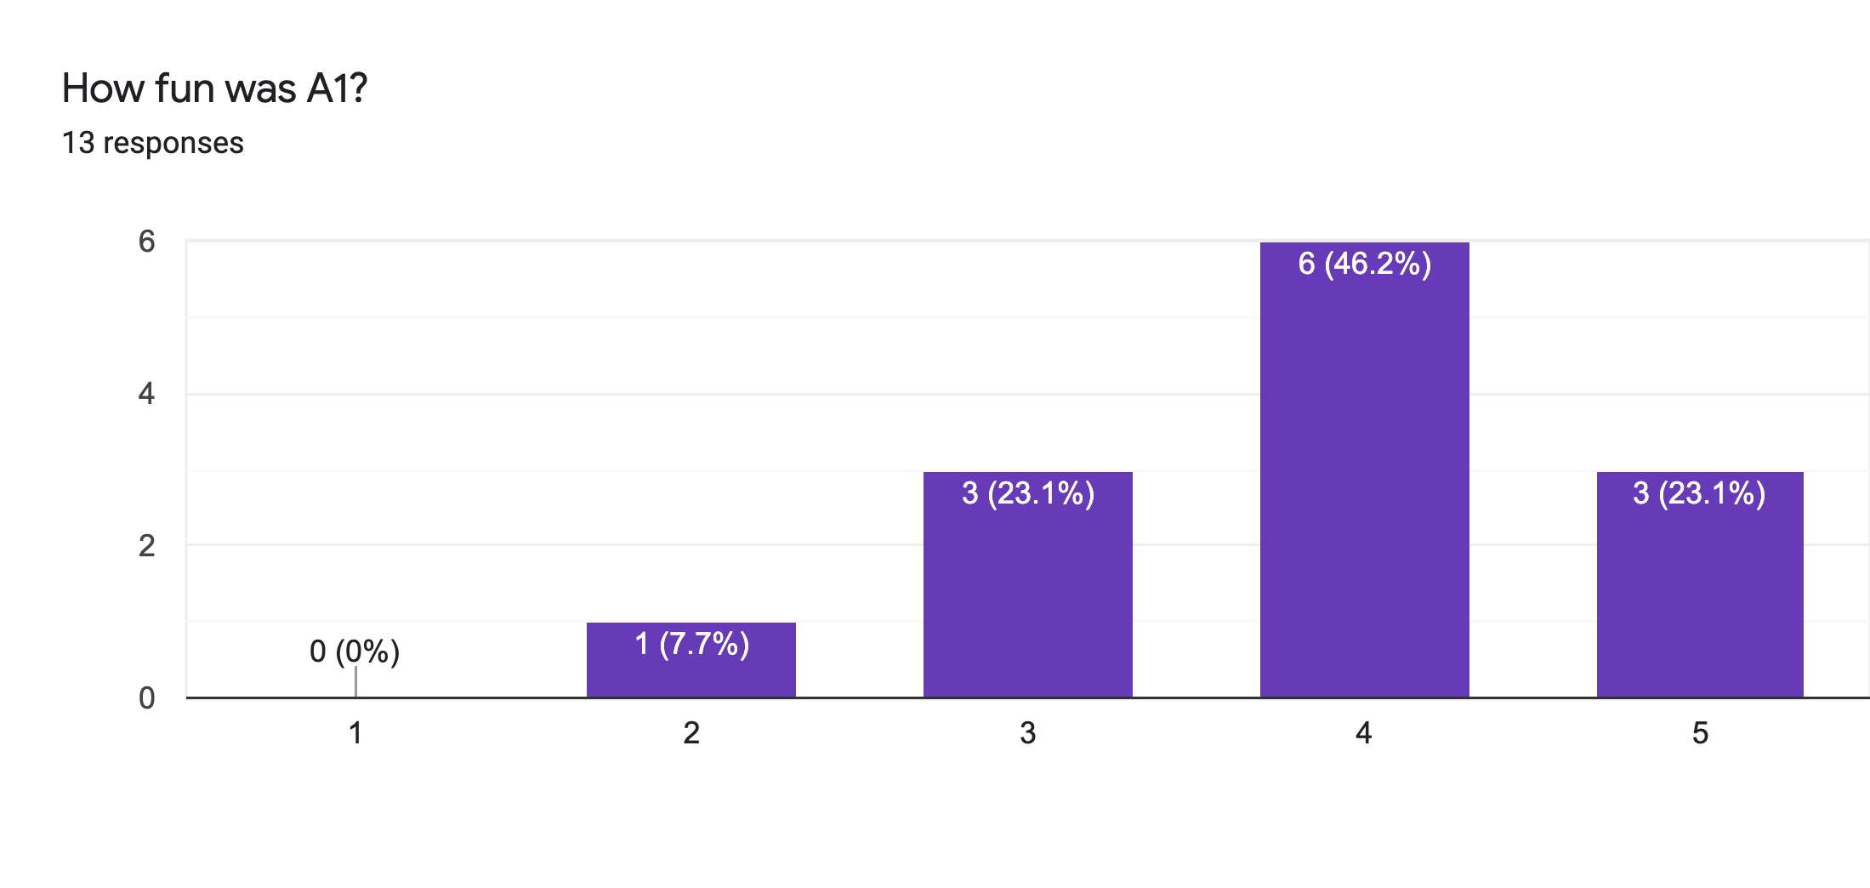
Main Comments
Vague Instructions
Bugs 🙏

Slide 43
Reviews
Strengths
Clear, honest writing
Ability to scale up/out is a big win!
Experiment design + explanation: A+

Slide 44
Reviews
Weaknesses
Lacks baselines
Aggregation?
Explain terms
How to choose partitioning key?
If scales to 1000+ nodes, what bottlenecks?
Failure on recovery?

Slide 45
Class 4

Slide 46
Do The Following
Turn video on
Type in chat or say:
A book/article I recently read
was ___ ______
3. Click when done

Slide 47

Today’s session
Finish previous class NO NEED!
Single Machine Joins.
Poll: paper reviews in pairs?

Slide 48
Today’s session
Finish previous class NO NEED!
Single Machine Joins.
Poll: paper reviews in pairs?
Poll: random pairing each week?

Slide 49
Breakout
Discussion:
Is a hot dog a sandwich? Discuss
Notetaker:
Summarize the discussion (~30s)

Slide 50
Discussion
Novelty
Theoretical guarantees
Experiment design

Slide 51
Class 3

Slide 52
Do The Following
Turn video on
Type in chat or say:
My favorite morning drink is ___ ___
(as much detail as you wish)
3. Click
Participants
Chat

Slide 53
Today’s session
Finish previous class
Multi-dimensional indexing
A1 is out, due 9/20

Slide 54
Breakout
Discussion:
Share your favorite quick cooking recipe,
or what you would like to cook
Notetaker:
Summarize the discussion (~30s)

Slide 55
Discussion
Novelty
Theoretical guarantees
Experiment design

Slide 56
Class 2

Slide 57
Turn video on,
enable mic & say:
“Hi, this is _(name)_,
I ate ___________ for breakfast”
Click when done
Participants
Chat

Slide 58
Logistics
Walk through
A0
Paper Reviews
Project list is up (still evolving)
Course goal
You feel comfortable reading papers + conducting research
Research ~ answering your own questions

Slide 59

Today’s session
Finish previous class
Review classic DBMS components
Notes on w6113.github.io

Slide 60
#ScholarStrike
Notes:
Supposed to be a two day strike where you don’t do any professor related tasks and learn about BLM and challenges of underrepresented people, and what can be done to help

Slide 61
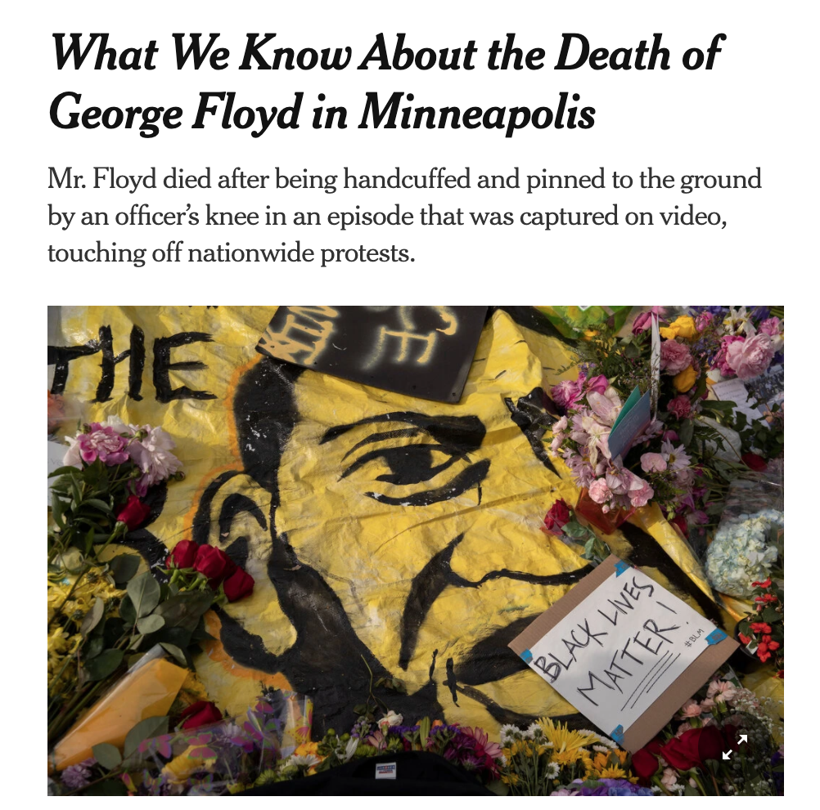
Black Lives Matter
Notes:
Discuss where all of this started and popularized this year, which, for me was the black lives matter protests.
BLM has been around for many years, but the very public, and unfair, murders of black people by police ignited the movement
For instance, geore floyd

Slide 62

Black Lives Matter
Notes:
Breonna Taylor was a nurse just at home in her apartment

Slide 63
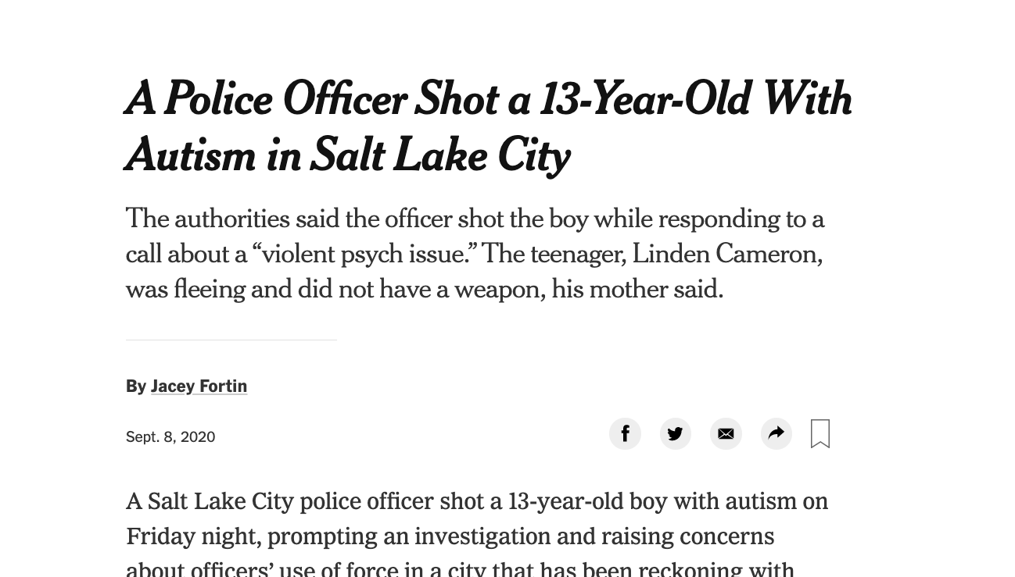
Black Lives Matter
Notes:
Linden Cameron was a 13 year old shot in the back

Slide 64

Black Lives Matter
Notes:
And Daniel Prude who was pinned and hooded by officers, who then blamed it on drug overdose, which leverages deep seated biases about black people.
These events are tragic, and simply symptoms of a deep disparity between African americans and the rest of America.
The US has historically treated immigrants of all kinds poorly, but African americans have been systematically oppressed from day one of the nation’s founding.
BLM is simply the manifestation of the outrage at this inequity

Slide 65

Notes:
Recently the WNBA led the sports world in going on a strike to further publicize this issue, and other sports leaguse followed.
ScholarStrike was a reaction by academics in support of this

Slide 66
Search terms to learn more
john oliver police
Netflix 13th
The case for reparations
shutdownstem
Notes:
Rather than cancel class, I’ll list here terms that are worth searching for to educate your self a bit about what’s going on. We will share these terms in the slack.
These are issues that I am not an expert in either, but I am happy to discuss these in recitation or OH.

Slide 67
Your Tasks for next class
Submit reviews for Tuesday
Submit Assignment 0 by 9/13 11:59PM EST
w6113.github.io

